Slide 1
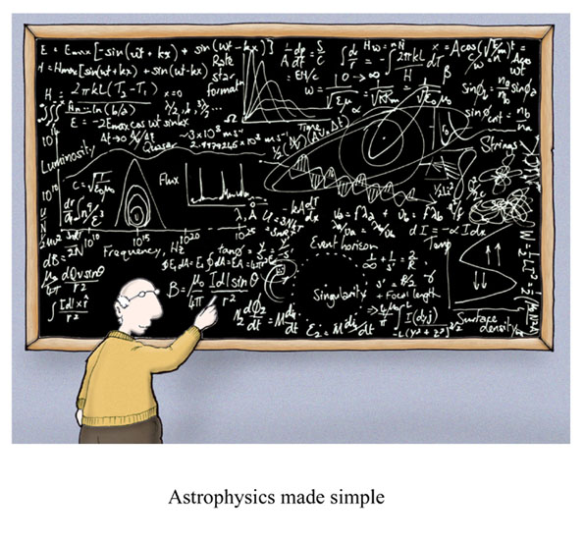
Uncertainty and Significant Figures
Cartoon courtesy of Lab-initio.com

Slide 2
Uncertainty in Measurement
A digit that must be estimated is called uncertain. A measurement always has some degree of uncertainty.

Slide 3
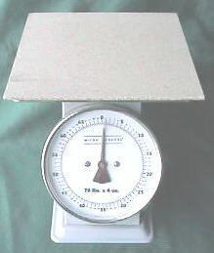
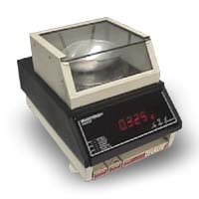
Why Is there Uncertainty?
Measurements are performed with instruments
No instrument can read to an infinite number of decimal places
Which of these balances has the greatest uncertainty in measurement?

Slide 4
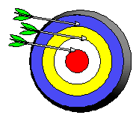
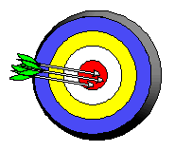
Precision and Accuracy
Accuracy refers to the agreement of a particular value with the true value.
Precision refers to the degree of agreement among several measurements made in the same manner.
Neither accurate nor precise
Precise but not accurate
Precise AND accurate

Slide 5
Rules for Counting Significant Figures - Details
Nonzero integers always count as significant figures.
3456 has
__ significant figures

Slide 6
Rules for Counting Significant Figures - Details
Figures with an Expressed Decimal
- Start at the left
- As soon as you encounter a non-zero digit, begin counting and continue until you reach the last digit.
0.0486 has
___ significant figures

Slide 7
Rules for Counting Significant Figures - Details
Figures with an Expressed Decimal
- Start at the left
- As soon as you encounter a non-zero digit, begin counting and continue until you reach the last digit.
16.07 has
___ significant figures

Slide 8
Rules for Counting Significant Figures - Details
Figures without an Expressed Decimal
- Start at the right.
- As soon as you encounter a non-zero digit, begin counting and continue until you reach the last digit.
9300 has
___ significant figures

Slide 9
Rules for Counting Significant Figures - Details
Figures without an Expressed Decimal
- Start at the right.
- As soon as you encounter a non-zero digit, begin counting and continue until you reach the last digit.
12500 has
___ significant figures

Slide 10
Rules for Counting Significant Figures - Details
Exact numbers have an infinite number of significant figures.
1 foot = 12 inches, exactly
1 m = 100 cm, exactly

Slide 11
Sig Fig Practice #1
How many significant figures in each of the following?
1.0070 m →
__ sig figs
17.10 kg →
__ sig figs
100,890 L →
__ sig figs
3.29 x 10³ s →
__ sig figs
0.0054 cm →
__ sig figs
3,200,000 →
__ sig figs

Slide 12
Sig Fig Practice #2
How many significant figures in each of the following?
4.623 km →
__ sig figs
0.61503 g →
__ sig figs
0.0025 m³ →
__ sig figs
1.539 x 10⁻⁴ s →
__ sig figs
2.1000 cm →
__ sig figs
1.00078 L→
__ sig figs

Slide 13
Rounding
Before we begin calculations, we must review the rules for rounding. Round each of the following to the indicated number of significant digits.
2.6325 cm to 3 sig figs →
0.278 L to 1 sig fig →
25.5 m to 2 sig figs →
26.5 m to 2 sig figs →
12462 km to 3 sig figs →
0.0012583 s to 2 sig figs →
3204001 mm to 3 sig figs →

Slide 14
Rules for Significant Figures in Mathematical Operations
Multiplication and Division: # sig figs in the result equals the number in the least precise measurement used in the calculation.
6.38 x 2.0 =
12.76 → __ (__ sig figs)

Slide 15
Sig Fig Practice #3
Calculation
Calculator says:
Answer
3.24 m x 7.0 m
100.0 g ÷ 23.7 cm³
0.02 cm x 2.371 cm
710 m ÷ 3.0 s
1818.2 lb x 3.23 ft
1.030 g ÷ 2.87 mL

Slide 16
Rules for Significant Figures in Mathematical Operations
Addition and Subtraction: The number of decimal places in the result equals the number of decimal places in the least precise measurement.
6.8 + 11.934 =
18.734 → ____ (__ sig figs)

Slide 17
Sig Fig Practice #4
Calculation
Calculator says:
Answer
3.24 m + 7.0 m
100.0 g - 23.73 g
0.02 cm + 2.371 cm
713.1 L - 3.872 L
1818.2 lb + 3.37 lb
2.030 mL - 1.870 mL

Slide 18
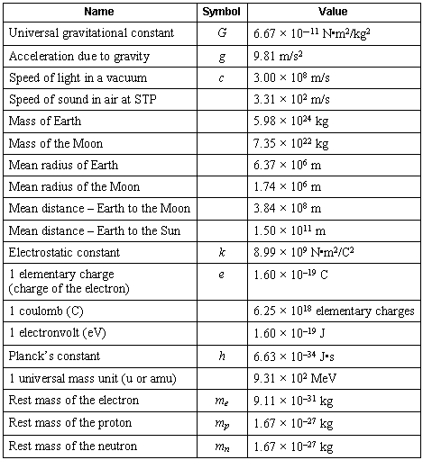
Scientific Notation

Slide 19
Scientific Notation
In science, we deal with some very LARGE numbers:
1 mole = 602000000000000000000000
In science, we deal with some very SMALL numbers:
Mass of an electron =
0.000000000000000000000000000000091 kg

Slide 20
Imagine the difficulty of calculating the mass of 1 mole of electrons!
0.000000000000000000000000000000091 kg
x 602000000000000000000000
???????????????????????????????????

Slide 21
Scientific Notation:
A method of representing very large or very small numbers in the form:
M x 10^{n}
M is a number between 1 and 10
n is an integer

Slide 22
.
2 500 000 000
9
8
7
6
5
4
3
2
1
Step #1: Insert an understood decimal point
Step #2: Decide where the decimal must end
up so that one number is to its left
Step #3: Count how many places you bounce
the decimal point
Step #4: Re-write in the form M x 10^{n}

Slide 23
2.5 x 10⁹
The exponent is the number of places we moved the decimal.

Slide 24
0.0000579
1
2
3
4
5
Step #2: Decide where the decimal must end
up so that one number is to its left
Step #3: Count how many places you bounce
the decimal point
Step #4: Re-write in the form M x 10^{n}

Slide 25
5.79 x 10⁻⁵
The exponent is negative because the number we started with was less than 1.

Slide 26
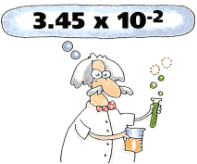
PERFORMING CALCULATIONS IN SCIENTIFIC NOTATION
ADDITION AND SUBTRACTION

Slide 27
Review:
Scientific notation expresses a number in the form:
M x 10^{n}
n is an integer
1 ≤ M < 10

Slide 28
4 x 10⁶
IF the exponents are the same, we simply add or subtract the numbers in front and bring the exponent down unchanged.
+ 3 x 10⁶
7
x 10⁶

Slide 29
The same holds true for subtraction in scientific notation.
4 x 10⁶
- 3 x 10⁶
1
x 10⁶

Slide 30
4 x 10⁶
If the exponents are NOT the same, we must move a decimal to make them the same.
+ 3 x 10⁵

Slide 31
4.00 x 10⁶
4.00 x 10⁶
+ 3.00 x 10⁵
+ .30 x 10⁶
4.30
x 10⁶
Move the decimal on the smaller number!

Slide 32
A Problem for you…
2.37 x 10⁻⁶
+ 3.48 x 10⁻⁴

Slide 33
Solution…
002.37 x 10⁻⁶
2.37 x 10⁻⁶
+ 3.48 x 10⁻⁴

Slide 34
Solution…
0.0237 x 10⁻⁴
+ 3.48 x 10⁻⁴
3.5037 x 10⁻⁴

