Slide 1
Welcome to Chemistry 111/112
Mrs. S. Gingras Harrison Trimble High School

Slide 2
Classroom Procedures
Arriving/Leaving
Bathrooms and Drinks
Eating in Class
Electronic Devices/Earphones
Fire Drills
Need 2 volunteers per class
Academic Dishonesty Policy

Slide 3
Being Successful in this Class
Aptitude
Attitude
Tips for Passing Science
Success is not FINAL; Failure is not FATAL

Slide 4
Predicting the Future

Slide 5
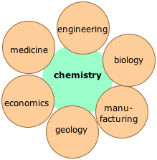
Course Introduction
Description and Prerequisites
Assessments
Required Materials
Expectations
Homework
Extra Help
Labs

Slide 6
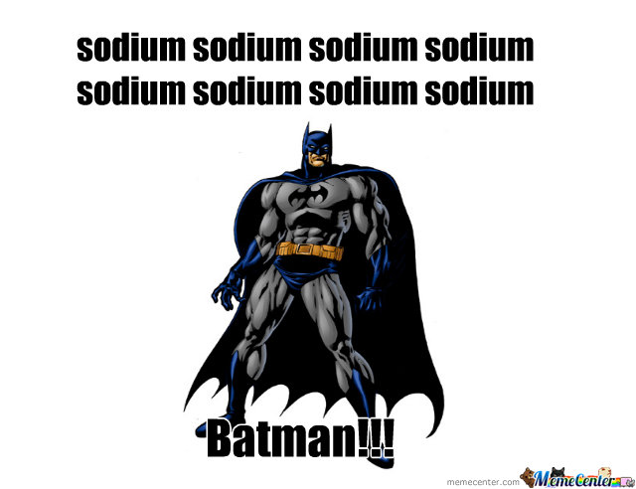
Other Course Information
Syllabus
Text Book
Attendance
Course Changes
Other Resources

Slide 7
Remainder of the Week
Diagnostic Assessment
Text Book Scavenger Hunt
Criteria for Portfolio
Chapter 2 Guided Reading
Chapter 2 Quiz

